Slide 1
Multi Purpose PWM block
Feature supports:
Complementary output with programmable deadtime
Maximum duty cycle/reference limiter
Use C-block Trunc() for improved timing control
By: Arief Noor Rahman

Slide 2
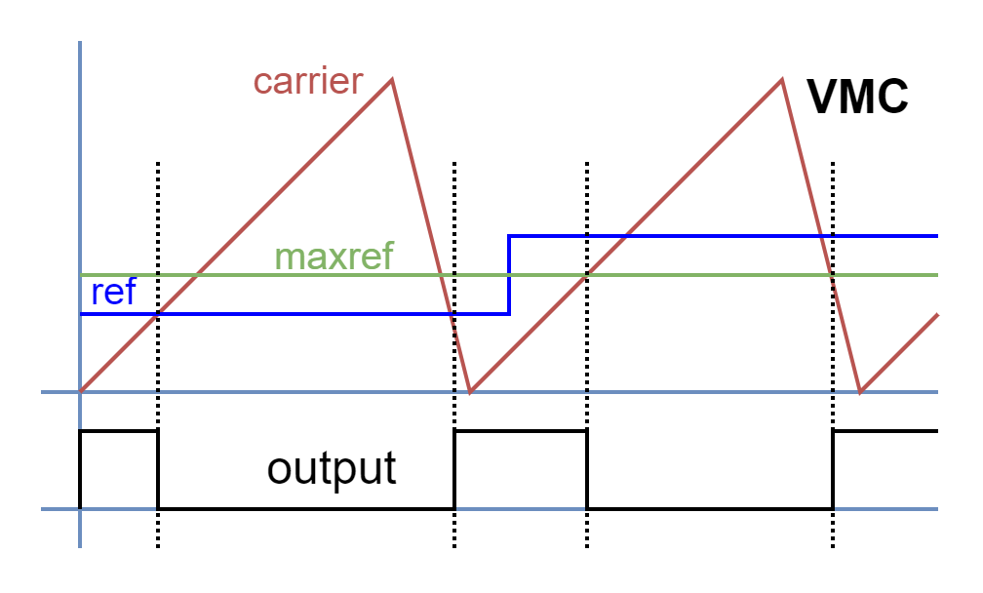
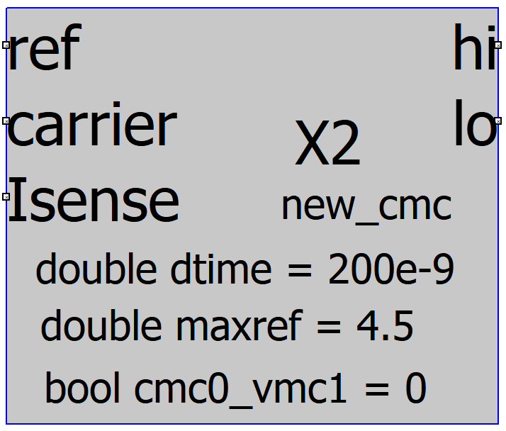
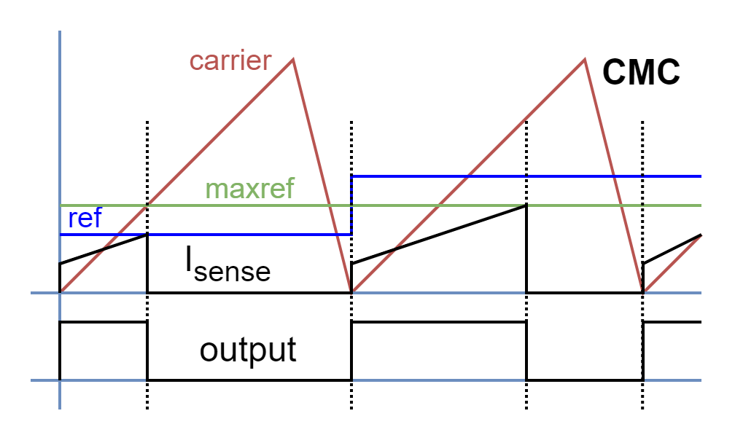
The PWM Block Operating Method
The “output” signal then will be connected to deadtime module to then generate the “hi” and “lo” signals

Slide 3
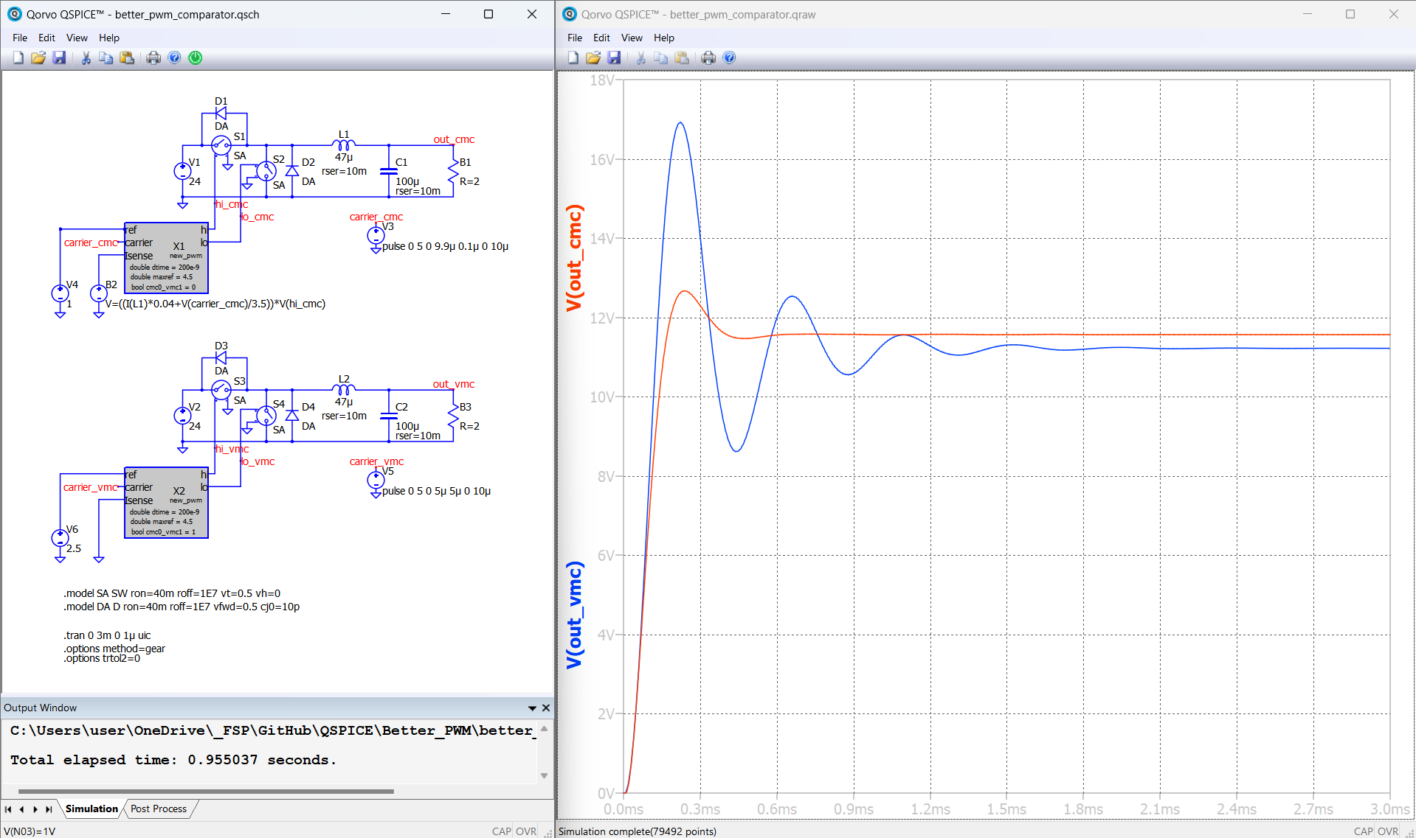
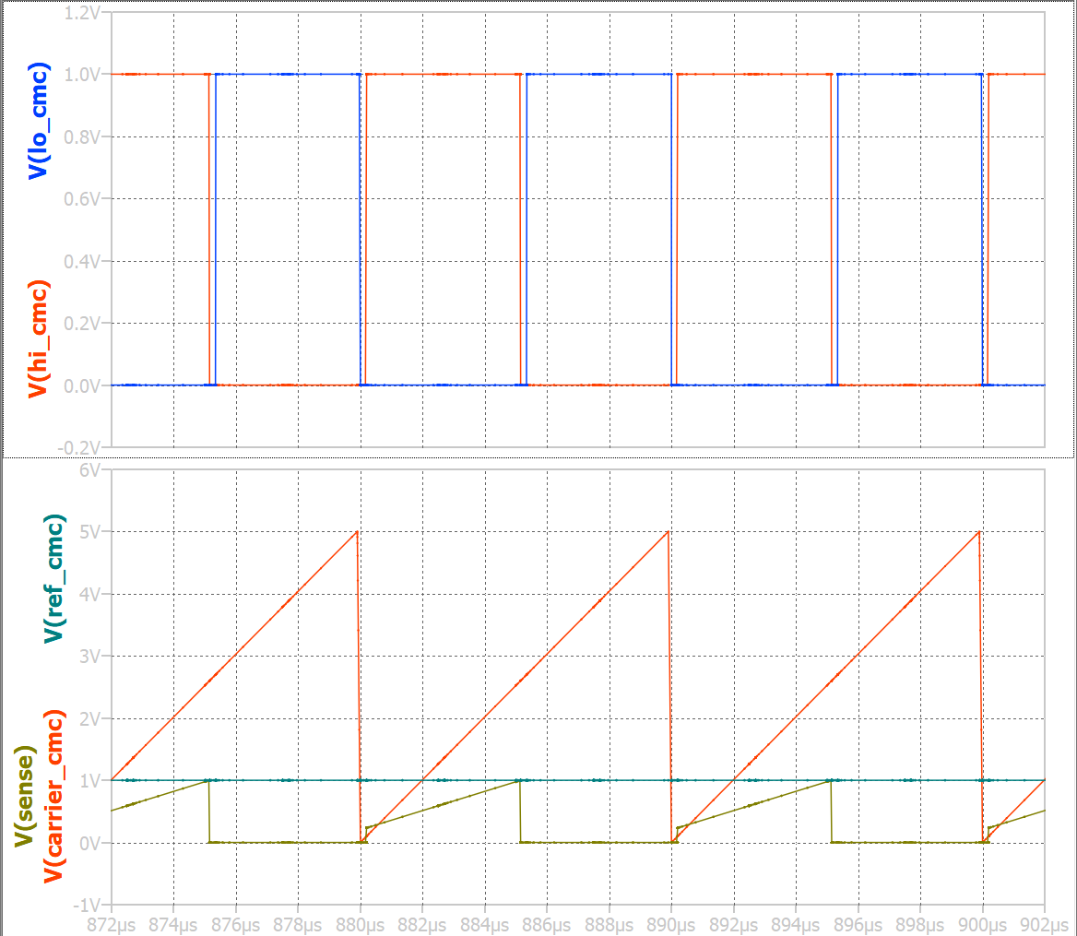
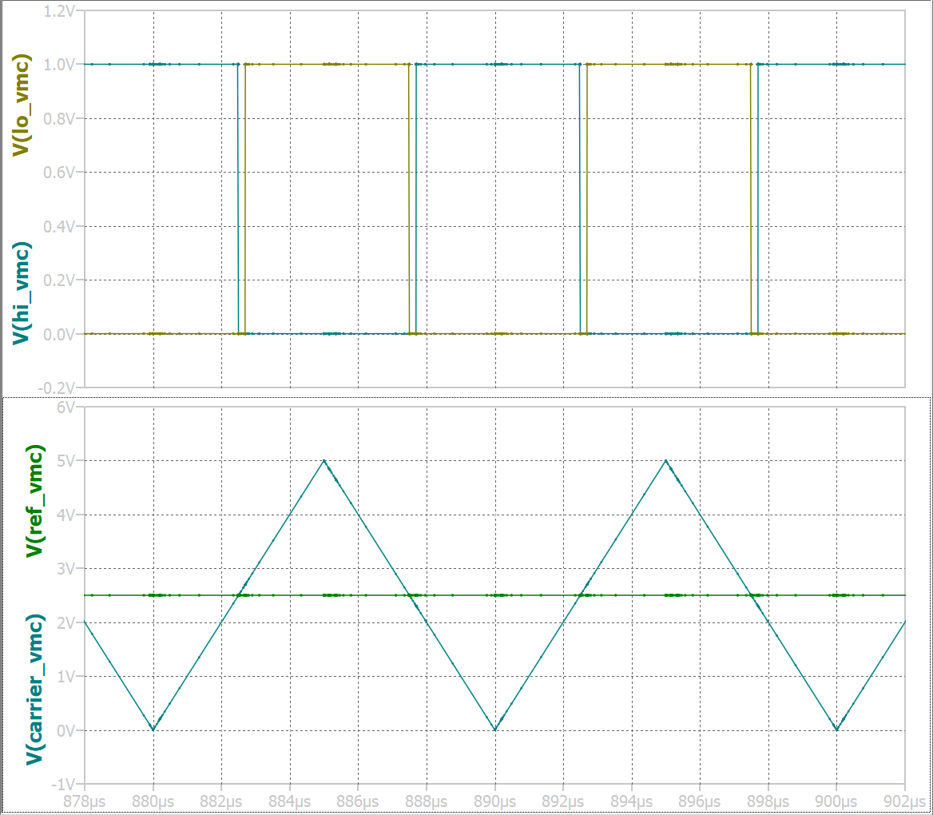
The Block Example Use Case (CMC and VMC)

